Slide 1


Slide 2
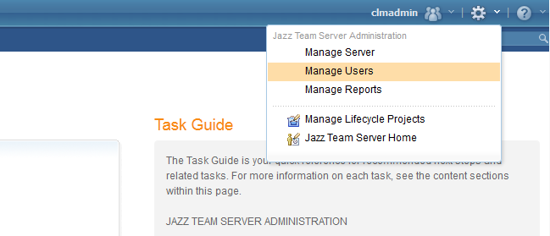
CREATING AN USER IN CLM
1. Login to Jazz Team Server admin panel (https://inbasdpc06348.techmahindra.com:9443/jts/admin) as administrator.
2. Navigate to the administration button , click on it and select Manage Users from the drop down.

Slide 3
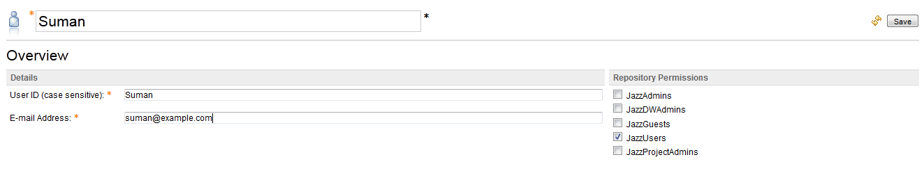
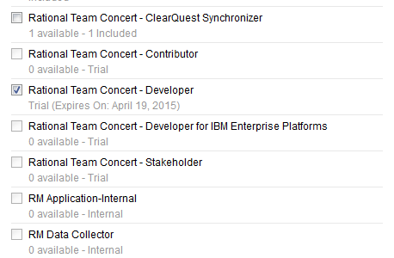
3. Now you are on the Active Users page. To create a new user click on Create User button on the top-right corner of the page. It will take you to the Edit User page, there enter a Username, User ID, e-mail and Photo (optional). Then, provide appropriate Client Access License and Repository Permissions to the user. Here, I am creating a simple user so I am giving the user the Rational Team Concert – Developer license and JazzUser repository permission. Then click Save to complete the user creation.

